Slide 1

Study 1: Influence of Parsimony and Sparsity in Predicting Turnover when Using Machine Learning VS Linear Regression
Diego Figueiras

Slide 2

Introduction
Notes:
Give an intro to ML here. Discussion what these programs are to get caught to speed

Slide 3
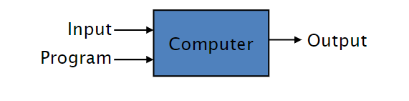
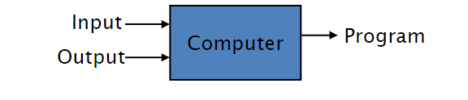
What is machine learning?
Theory-based approach
Empirical-based approach

Slide 4
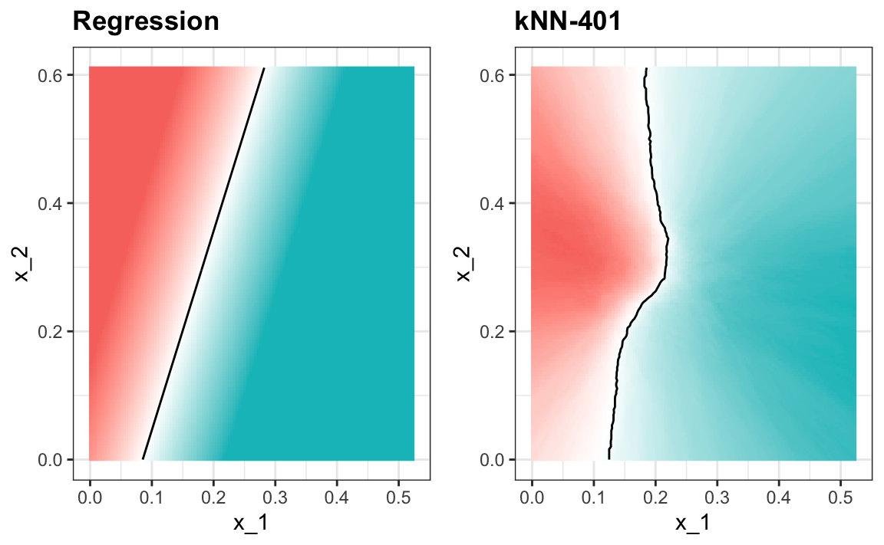
Benefits of Machine Learning

Slide 5
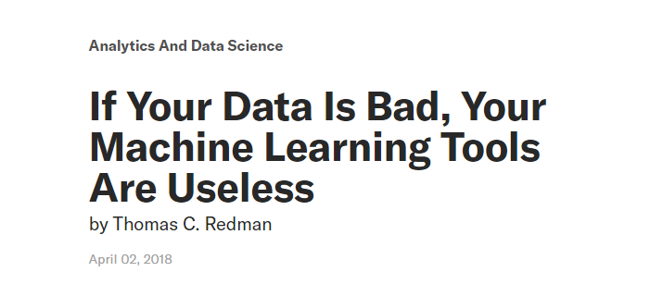

GIGO problem (garbage in, garbage out)

Slide 6
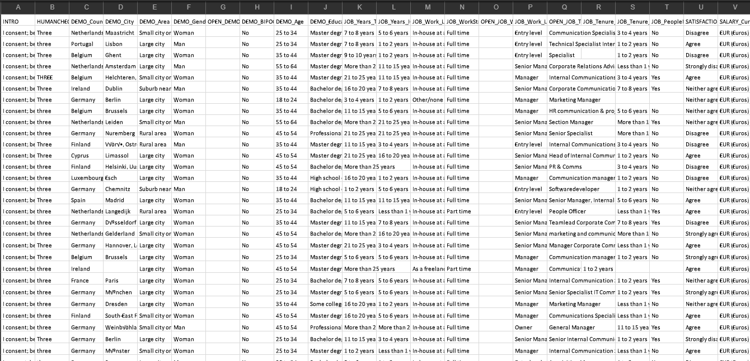
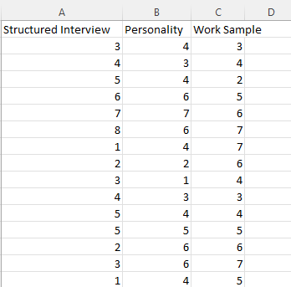
Parsimony and sparsity
Why use this...
when you can just use this?

Slide 7
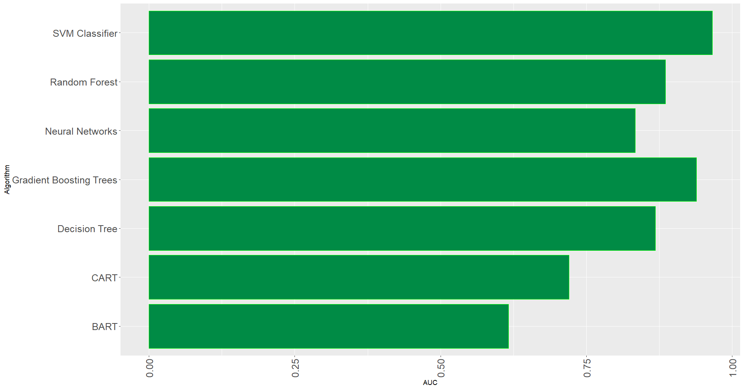
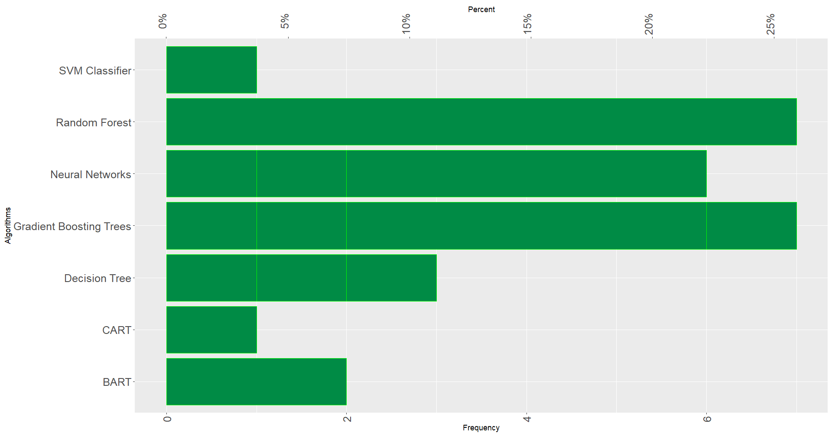
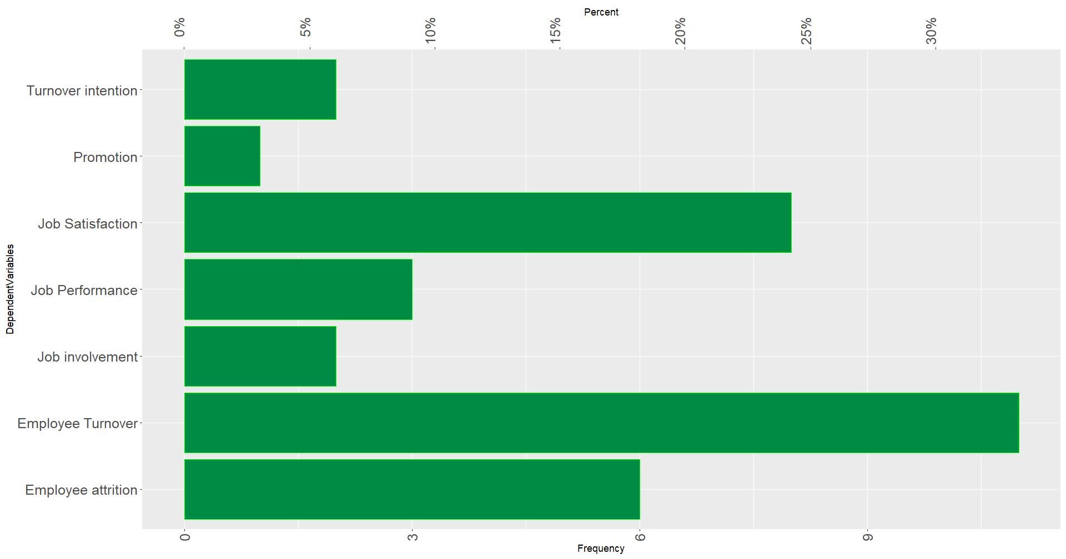
Key Findings from Prelims
GBT and SVM highest accuracies
Random Forest and GBT most common algorithms
Turnover most common DV
Notes:
Discuss here about some of the ML algorithms too

Slide 8
Conclusions
GBT producing the highest accuracy
Only two articles out of the twenty-seven reviewed had data with sample sizes above 260,000
Median events (people) per variable (EPV) was 44
Using machine learning algorithms with such small number of variables could compromise the bias-variance tradeoff, overfitting the data.

Slide 9

Hypotheses
H1
A) If the sample size is below 260,000, predictive accuracy metrics will be better when running a regression model than when running a ML algorithm.
B) If the sample is above 260,000, predictive accuracy metrics will be worse when running a regression model than when running a ML algorithm
H2:
A) If the events per variables is below 200, predictive accuracy metrics will be better when running a regression model than when running a ML algorithm.
B) If the events per variables is above 200, predictive accuracy metrics will be worse when running a regression model than when running a ML algorithm.
H3:
Model trained with work-related psychological constructs will show better predictive accuracy metrics over DV than the models trained using biodata variables.
H4:
Models will show better predictive accuracy metrics over DV when IO variables OR biodata are added

Slide 10

Data
Office of Personnel Management Federal Employee Viewpoint Survey
5 million responses
107 variables
Simulations
Survey data (to be collected)

Slide 11

Common ML algorithms
Decision trees
Neural networks
Support vector machines

Slide 12

Q&A

Slide 13

Study 2: Item Characteristic Curve estimation via Classical Test Theory specification
Notes:
Say this is another project I’ve been working with Dr. Kulas

Slide 14
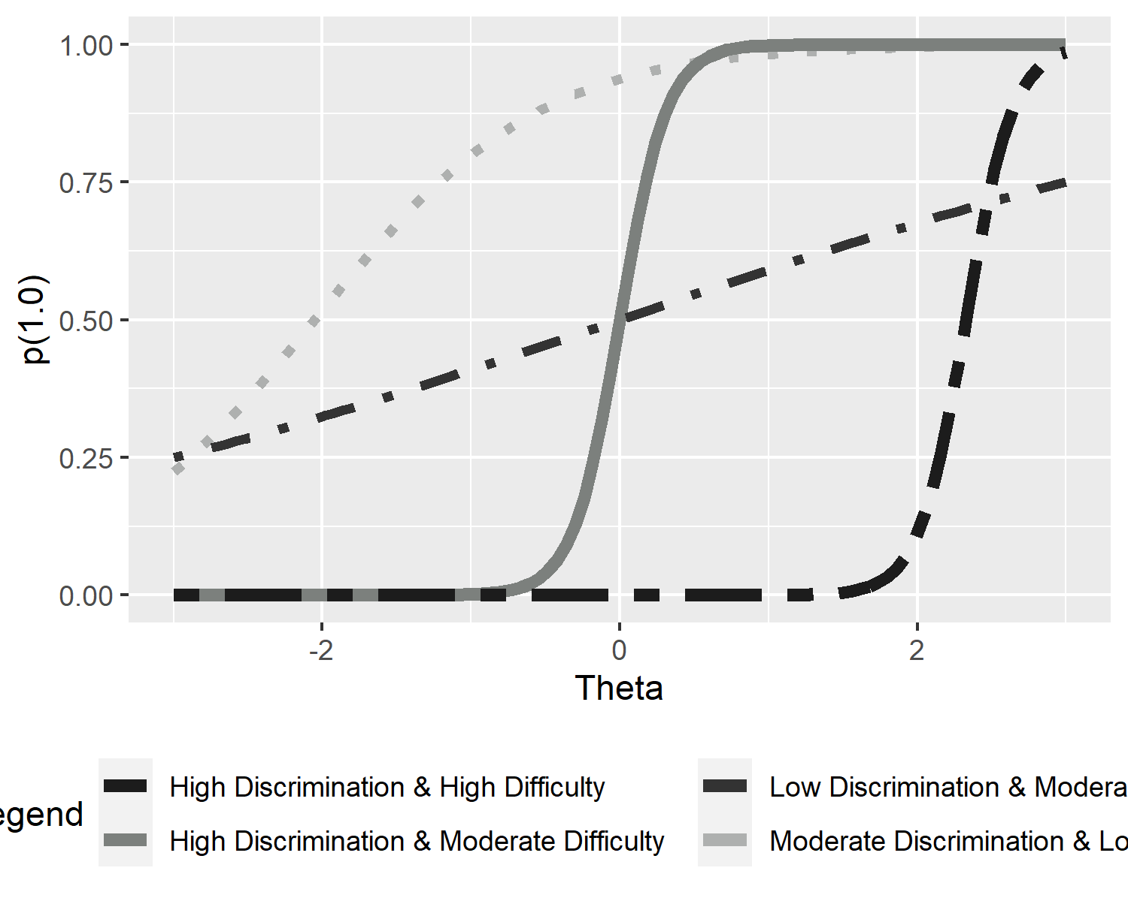
Item Characteristic Curves (ICC)

Slide 15
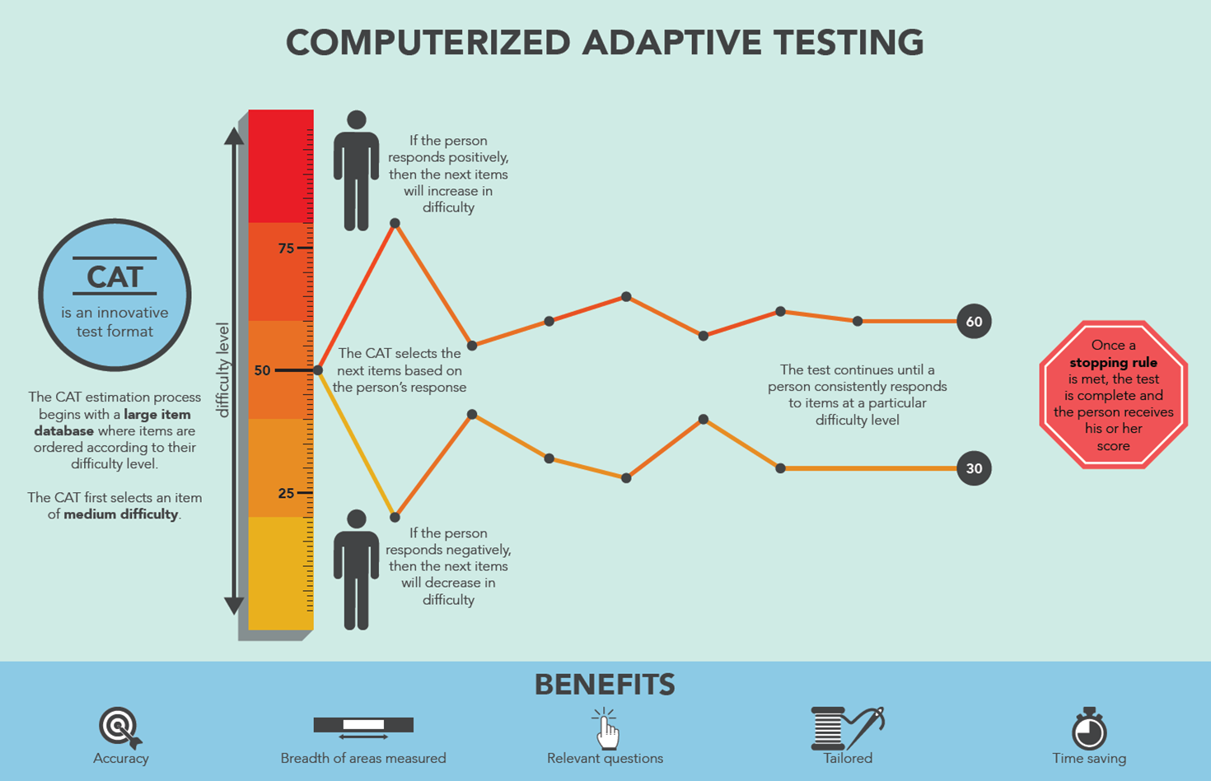
Item Response Theory

Slide 16
Talk about IRT parameters and CTT statistics
A, B, C
2PL, 3PL
P-values (pseudo-b)
Corrected item total correlations (pseudo-a)
Notes:
Make this 2 slides

Slide 17
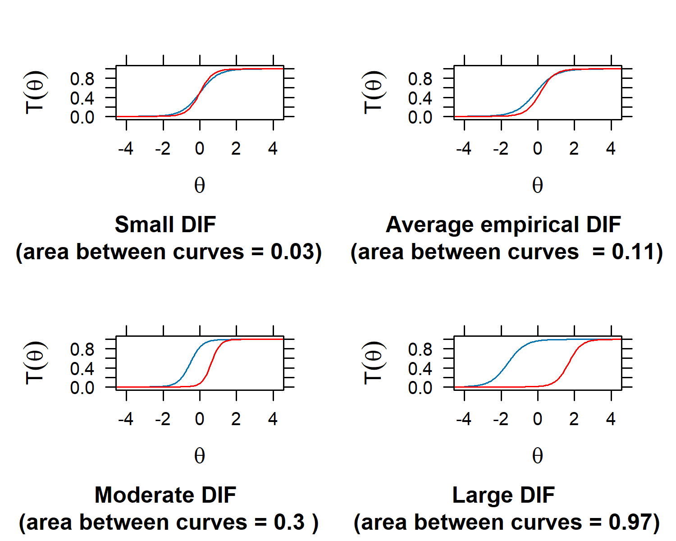
IRT vs CTT when plotting ICC

Slide 18
Data
Simulations
ETS data (TOEFL)
Notes:
Explain the simulations (100 items, 10,000 “respondents”)

Slide 19
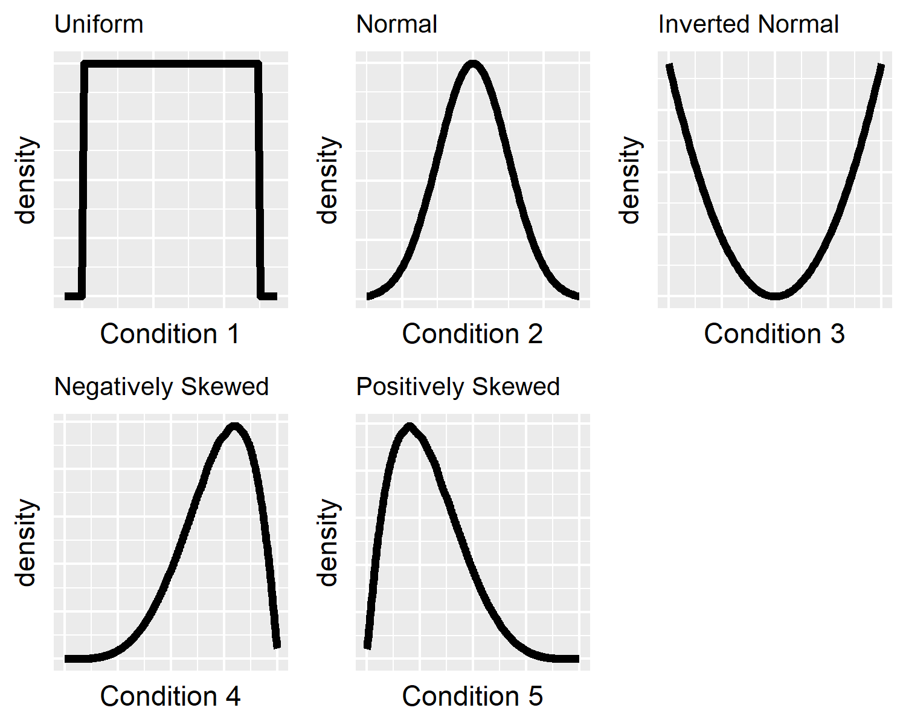
Simulated conditions

Slide 20
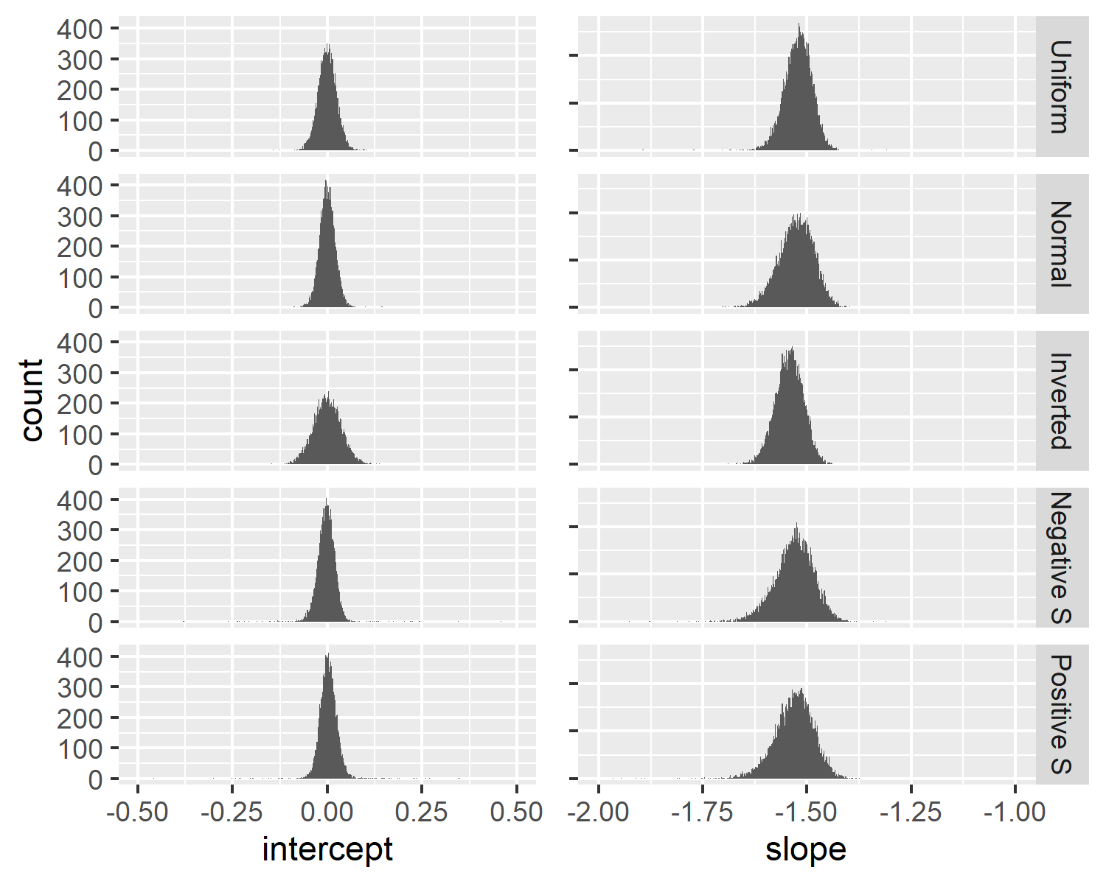
Results

Slide 21
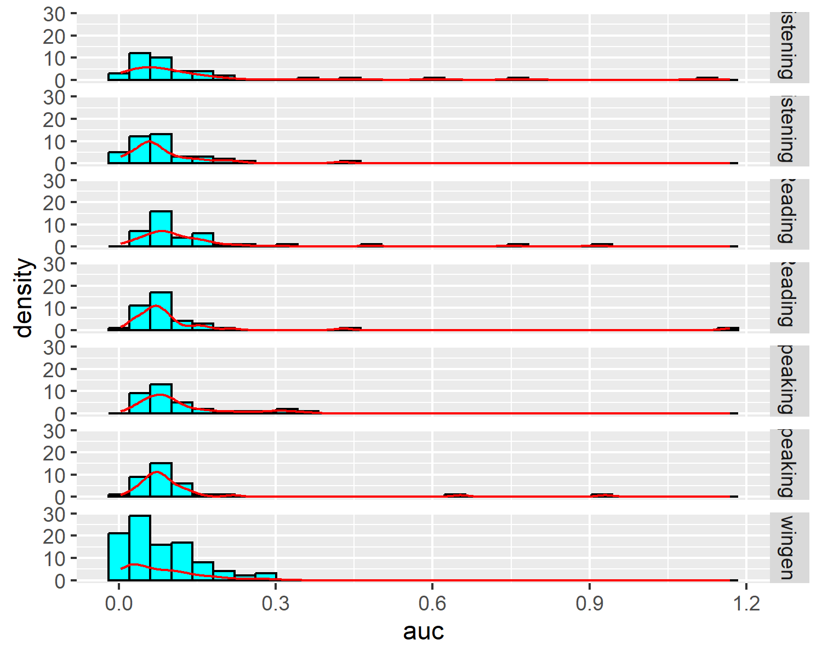
Results (cont.)

Slide 22
Take-away
ICC good tool for CTT practitioners
Package in R (“ctticc”)
Test Characteristic Curves next

Slide 23
Q&A

